Slide 1
B BUS 320 Marketing Plan
Notes:
Jolie Bui

Slide 2

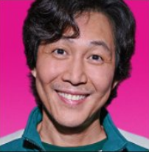
Who’s Watching?
Darren Chen
Notes:
Jolie Bui

Slide 3




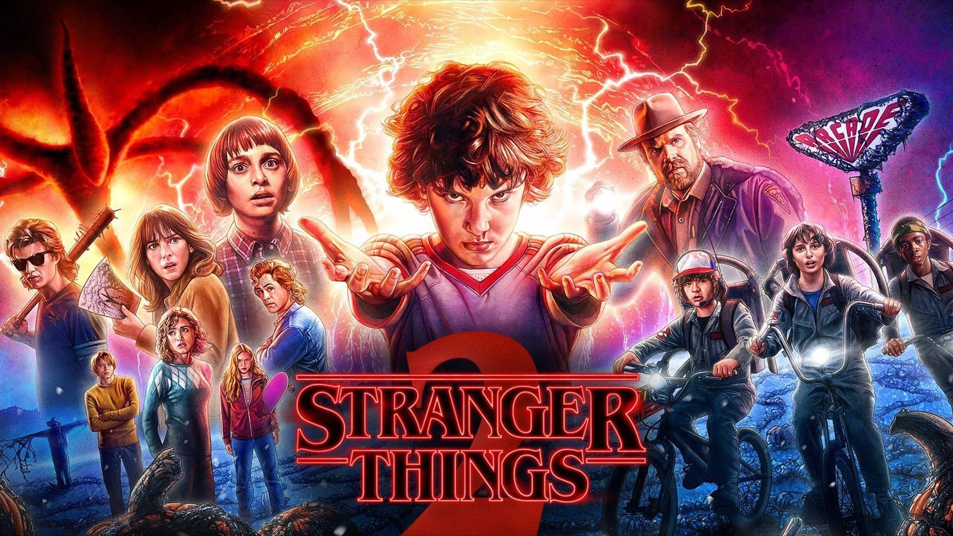
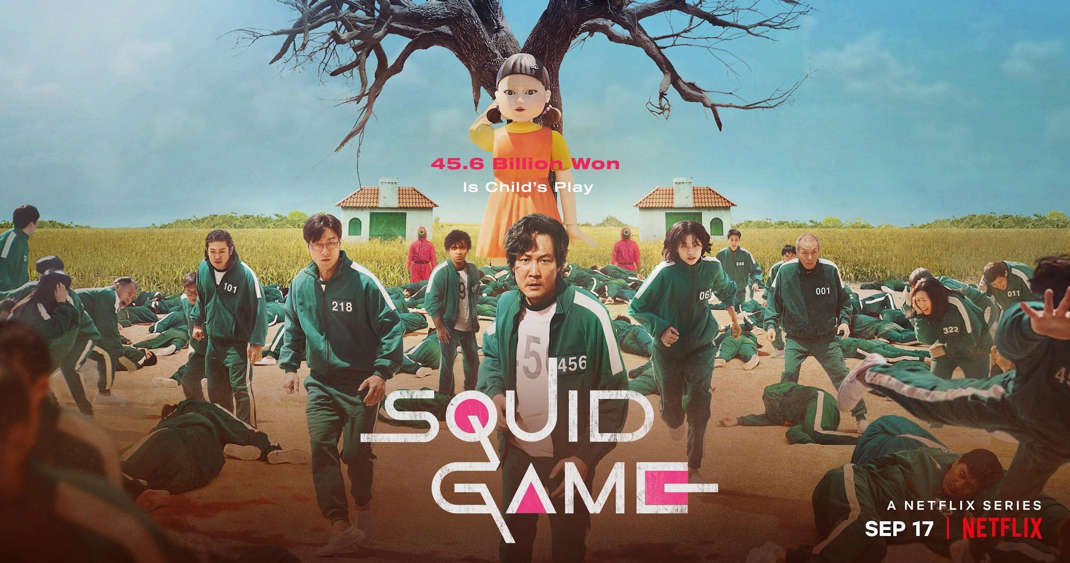

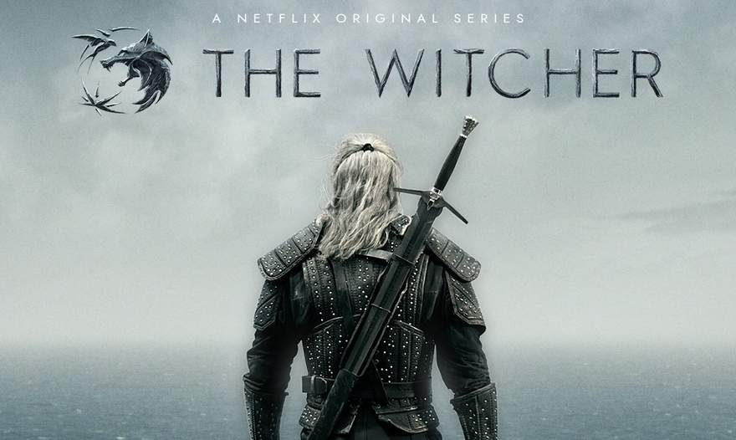
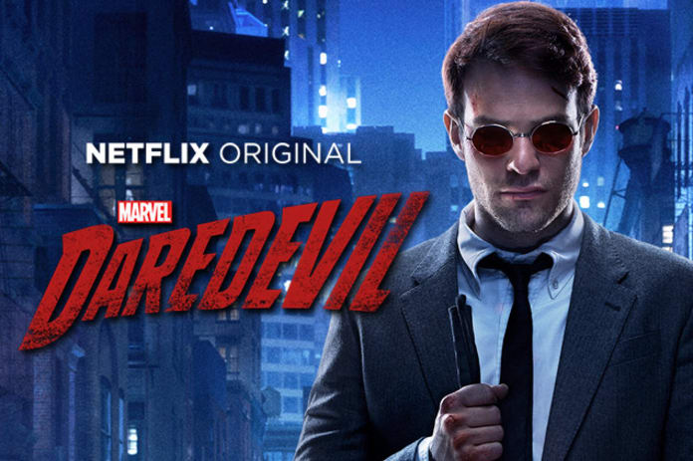
INTRODUCTION
Netflix faces the challenge of attracting and retaining subscribers
Our managerial problem is
Slowing Sales due to increasing streaming competition and poor managerial decisions
Notes:
Jolie Bui: our chosen company is netflix which is a leading online subscription-based streaming service and production company. As of right now, netflix is facing the challenge of attracting and retaining subscribers. Therefore, our managerial problem is slowing sales which is due to streaming competitors and poor managerial decisions.

Slide 4


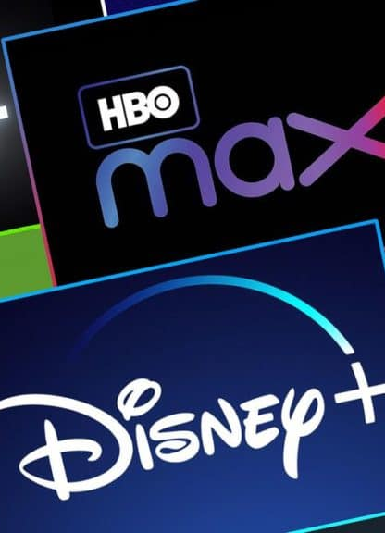
SITUATION ANALYSIS
Netflix must develop a better marketing strategy to increase subscribers, customer retention, and sales.
Market Description
Product Review
Competitive Review
Netflix is one of the world’s leading entertainment services in over 190 countries providing TV series, films, and games.
Netflix has a large collection of TV shows and movies with exclusive acclaimed originals.
Netflix is currently experiencing loss of sales due to major competition with companies such as Hulu, Amazon Prime, and Disney+
Notes:
Taylor

Slide 5




SITUATION ANALYSIS
Pt 2.
LUCIFER
NARCOS
Channels & Logistics Review
Recent Managerial Decisions
Market Saturation
LUCIFER
Netflix’s digital marketing involves multi-channel marketing where social media, print media, websites, YouTube, and billboards for promotion.
Netflix decides to remove family sharing on accounts.
Companies such as Hulu, Disney+, Amazon Prime, Crunchyroll, are becoming major competitors and influencing Netflix’s market share and sales.
Notes:
Taylor

Slide 6

4
Strategy (STP)
Segment | Target | Positioning
Segment
Age
Profession
Education Field
Country
Target
Working Adults / Millennials
Students / Generation Z
Families / Friend Groups
North America / Europe
Positioning
Targeted Advertisement through Gaming and Tier Subscription targeting multiple customer bases such as Gamers and Families
Attention towards hubs of Students and Young Adults
Studio
Production Company (distributor)
Production Company (producer)
Director (usually as “A ‘Director’ Film”)
FILM TITLE
Main Cast
Supporting Cast
Casting Director
Composer
Costume Designer
Associate Producer(s)
Editor
Production Designer
Cinematographer
Executive Producer
Producer
Writer(s)
Director (Second reference)
Notes:
Dee

Slide 7
SWOT ANALYSIS
Strengths: Lower costs for target market, Benefits for the whole family, Target audience expansion.
Weaknesses: Funding for films, Brand image & loss of subscribers.
Opportunities: Partnerships with other production companies to provide more exclusive content.
Threats: Disney plus/other competitors expanding and capturing target audience.
Notes:
Haben is presenting SWOT analysis

Slide 8




4
ACTION PLAN
Product: Bundling Xbox Cloud Gaming with Netflix Premium Plan
Price: Bundle $20 per month
Xbox $15/month
Netflix $15/month
Promotion: First 3 months will be $8/month
Place: Advertising on Youtube, Google ads and in place of current Netflix advertisements
Notes:
Billy Hinman

Slide 9
PRICING
Free Plan w/ Ads
Standard w/ EDU or Vet Discount
Standard
Premium w/ Game Pass Bundle
Price
Free
$9.99
$14.99
$19.99
Video Quality
Good
Better
Better
Best
Resolution
1080p
2K HDR
2K HDR
4K HDR
Number of Devices
2
6
6
Unlimited
Notes:
Darren Chen

Slide 10

Notes:
Robert

Slide 11
Notes:
Robert

